Slide 1

Link Prediction on Hike’s Network
3rd Place Solution - Approach Overview
Team Name: DataGeek|SVJ
Members: Thakur Raj Anand and Sourabh Vibhuti Jha

Slide 2
Data Overview
We were provided with the data with 77M node pairs out of which 2M pairs were connected on Hike
Each of these connection is directed such that a connection (a,b) implied a initiated chat with b
The data had 8M unique nodes
We were also provided with 13 anonymized features associated with each node

Slide 3

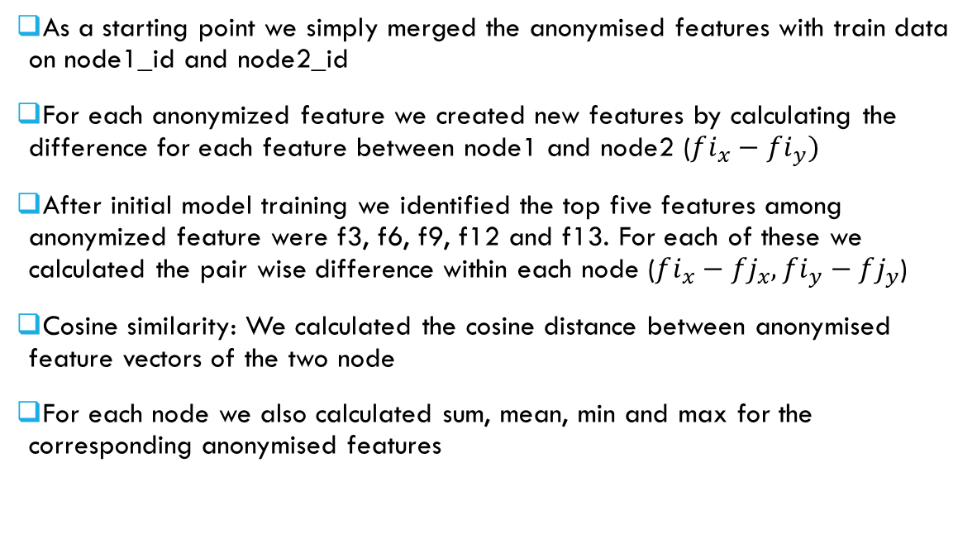
Feature Engineering – Using anonymised features
As a starting point we simply merged the anonymised features with train data on node1_id and node2_id
For each anonymized feature we created new features by calculating the difference for each feature between node1 and node2 ($fi_{x}−fi_{y})$
After initial model training we identified the top five features among anonymized feature were f3, f6, f9, f12 and f13. For each of these we calculated the pair wise difference within each node ($fi_{x}−fj_{x}, fi_{y}−fj_{y}$)
Cosine similarity: We calculated the cosine distance between anonymised feature vectors of the two node
For each node we also calculated sum, mean, min and max for the corresponding anonymised features

Slide 4
Graph based Features – PArt1 (Directed Graph)
We split the data into 10 folds, for each fold we used the other 9 folds to build a graph. For test we used the entire train data to build the graph
We build both directed as well as undirected graph wherever is_chat was 1
Directed Graph was used to create features like page rank and average neighbours for each node and the difference between the page ranks and average neighbours
The directed graph was also used to identify one sided connection. 90% of the connection were bi-directed so this was an important feature
Apart from this the total connections (along with bi-directed connections) to and from each nodes were also calculated, along with their averages for each node

Slide 5
Graph based Features – PArt1 (UNDirected Graph)
Using the undirected graph we computed connected components to identify cliques in the graph. Additional feature such as node count and average connections in each components were also calculated
Clustering coefficient for each node was computed
Number of common neighbours and common neighbours Jaccard similarity was also computed (for both directed and undirected graph)

Slide 6
Features using the all the Pairs
We were not entirely sure how the data (node1 node2 pairs) were generated, but we hypothesised that each pair of data represent phone contacts of node1
This allowed us to create more features similar to graph features like common contacts, number of contacts, bi-directed contacts etc.
We got decent lift, so this idea was somewhat validated

Slide 7
Some More Interesting Feature ideas
We found that nearly 1M pairs were self connections
Such connection had only 0.1% likelihood of is_chat compared to 3% within the data
Our hypothesis was that these are same customers / device / SIM and hence are very unlikely to chat with each other

Slide 8
Model Training
We used LightGBM to train the model
Since the data was huge, we ran most of the iteration on 20% data. This helped us to quickly iterate and test more features
Again due to the size of the data we had to use larger compute engine (64GB RAM, 16 cores to train)
The final submission was trained on 90% data on a 200GB machine

Slide 9
Key Takeaways
Anonymised features could only give 86-87% AUC. So we had to think of how to create more features using graph
Even though the data was anonymised we could still use domain knowledge to create a lot of features (100+)
Since the data was large, it was important to write optimized codes (both in terms of RAM and compute time) in order to quickly iterate and test more ideas
While working as a team, we created a consistent k-fold CV amongst us to get comparable local CV
We realised early on that feature engineering was the key to winning this competition so we spent maximum time on that

